Slide 1
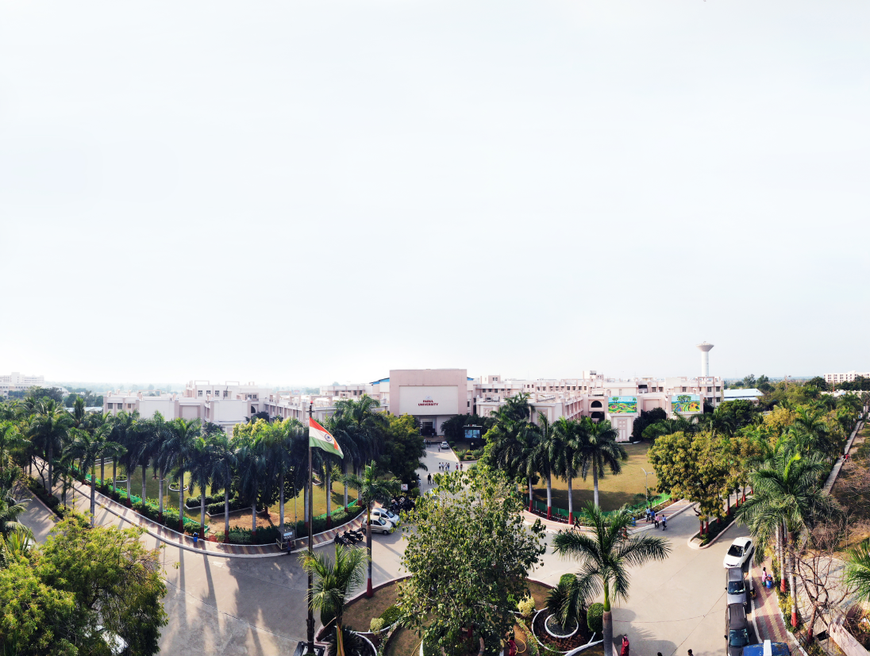



Plant Disease Prediction
Presented By:
NAITIK BHAVSAR (190303105079)
MESHWA SHAH (190303105106)
DHARM MEHTA (190303105010)
Supervised by:
Guide Name Dr. Amit Barve

Slide 2
OUTLINE
Introduction
why is it helpful
Why this project
Scope of this project
Objectives of PROJECT Work
Problem statement
Block diagram
Algorithms
Design Flow

Slide 3
Introduction
Plant disease detection is an Innovative and Enlightening System helping the users to know the disease, trainings or any interesting things taking place around their Area. This Organization aids the native community to keep themselves up to date about the events around their locality or zone or in their town. There are 2 things for this method to work; one for the image processing and another is machine learning.

Slide 4
Introduction
The user is permitted to sight the disease only of his town while user can supplement disease connected to any town. Admin will show if any misuse or inappropriate or false disease added by any users and will take specific act. The Front end used is Android Studio and backend as SQL Server. The user has to record into the system to using this app and can bring up-to-date his details as well.The healthy leaf is shown first and so on, the user can also restore the disease resultant the latest one shown first and current disease will be shut. The user can add a image and a title connected to the leaf

Slide 5
why is it helpful
Without proper identification of the disease and the disease-causing agent, disease control measures can be a waste of time and money and can lead to further plant losses. Proper disease diagnosis is therefore vital. Often, plant pathologists have to rely on symptoms for the identification of a disease problem.

Slide 6
Why this project
In this changing environment, appropriate and timely disease identification including early prevention has never been more important. There are several ways to detect plant pathologies. Some diseases do not have any visible symptoms, or the effect becomes noticeable too late to act, and in those situations, a sophisticated analysis is obligatory. However, most diseases generate some kind of manifestation in the visible spectrum, so the naked eye examination of a trained professional is the prime technique adopted in practice for plant disease detection. In order to achieve accurate plant disease diagnostics a plant pathologist should possess good observation skills so that one can identify characteristic symptoms

Slide 7
Scope of this project
This single project serves many users to view several disease.To find out whether the leaf is diseased or healthy, certain steps must be followed. Preprocessing of image, is bringing all the images size to a reduced uniform size. Then comes extracting features of a preprocessed image which is done with the help of HOG .HoG is a feature descriptor used for object detection. In this feature descriptor the appearance of the object and the outline of the image is described by its intensity gradients. One of the advantage of HoG feature extraction is that it operates on the cells created.

Slide 8
Objectives of PROJECT Work
Modern approaches such as machine learning and deep learning algorithm has been employed to increase the recognition rate and the accuracy of the results. Random forests are as a whole, learning method for classification, regression and other tasks that operate by constructing a forest of the decision trees during the training time. Unlike decision trees, Random forests overcome the disadvantage of over fitting of their training data set and it handles both numeric and categorical data.The histogram of oriented gradients (HOG) is an element descriptor utilized as a part of PC vision and image processing for the sake of object detection

Slide 9
Problem Statement
The problem of efficient plant disease protection is closely related to the problems of sustainable agriculture and climate change. Research results indicate that climate change can alter stages and rates of pathogen development; it can also modify host resistance, which leads to physiological changes of host-pathogen interactions. The situation is further complicated by the fact that, today, diseases are transferred globally more easily than ever before. New diseases can occur in places where they were previously unidentified and, inherently, where there is no local expertise to combat them . Inexperienced pesticide usage can cause the development of long-term resistance of the pathogens, severely reducing the ability to fight back. Timely and accurate diagnosis of plant diseases is one of the pillars of precision agriculture Shortened disease extracts from plants, every story to be printed as a short disease for the viewers. The viewers can luckily flip through the short sections as they want. Share disease and exciting sections with friends and family. The user is simplified with everything going around his town. Easy to use. The user can shot to the admin if the disease is not applicable or honest. • Because of winter season it is difficult to protect mo leaves. • The user can’t sight the disease of different towns. • User can add only one image per plant

Slide 10
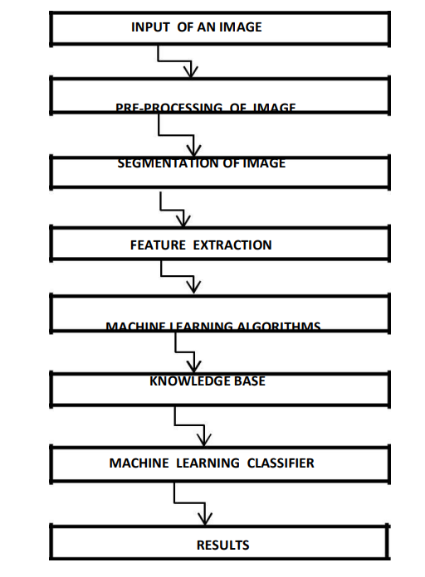
Block diagram

Slide 11
Algorithms
Sr No | Technique | Advantages | Disadvantages
1 | K-Nearest Neighbor (KNN) | Simpler classifier as exclusion of any training process. Applicable in case of a small dataset which is not trained. | Speed of computing distance increases according to numbers available in training samples. Expensive testing of each instance and sensitive to irrelevant inputs
2 | Radial Basis Function | Training phase is faster. Hidden layer is easier to interpret | It is slower in execution when speed is a factor.
3 | Probabilistic Neural Networks | Tolerant of noisy inputs. Instances classified by more than one output Adaptive to changing data. | Long training time. Large complexity of network structure. Need lot of memory for training data.
4 | Backpropagation Network | Easy to implement. Applicable to wide range of problems. Able to form arbitrarily complex nonlinear mappings | Learning can be slow. It is hard to know how many neurons as well as layers are required
5 | Support Vector Machine | Simple geometric interpretation and a sparse solution. Can be robust, even when training sample has some bias. | Slow training. Difficult to understand structure of algorithm. Large no. support vectors are needed from training set to perform classification task

Slide 12
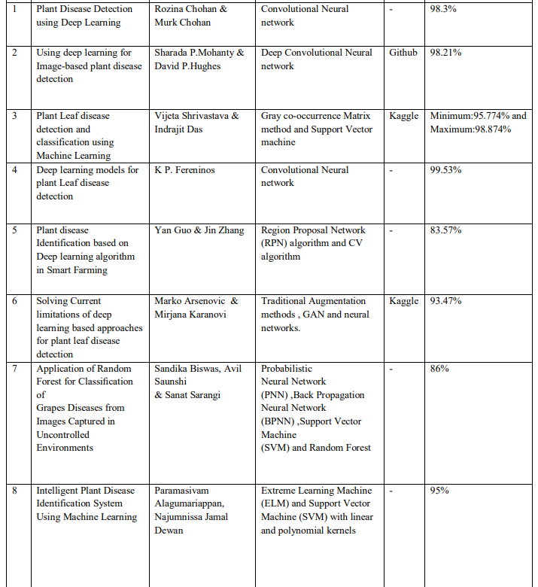
Current algorithms performances

Slide 13
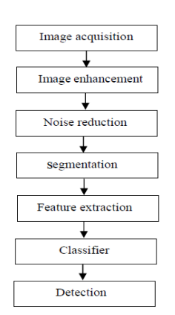
Design flow
TOOLS & TECH.
AI & ML
IMAGE PROCESSING
DATA SETS
LANGUAGES LIKE JAVA,PYTHON

